Slide 1
Applications of graph traversals
[CLRS] – problem 22.2 - Articulation points, bridges, and biconnected components
[CLRS] – subchapter 22.4 Topological sort
[CLRS] – subchapter 22.5 Strongly connected components

Slide 2
Graphs
Applications of Depth-First Search
  Undirected graphs:
    Connected components, articulation points, bridges
  Directed graphs:
    Cyclic/acyclic graphs
    Topological sort
    Strongly connected components

Slide 3
Connectivity, connected components
An undirected graph is called a connected graph if there is a path between any two vertices.
A connected component of an undirected graph is a subgraph in which any two vertices are connected to each other by paths, and which is connected to no additional vertices in the supergraph.

Slide 4
Connected components – Example
1
5
2
7
6
3
4

Slide 5
Finding Connected Comps by DFS
DFS-VISIT(G,s) reaches all nodes that are in the same connected component as s
The number of connected components is equal with the number of calls of DFS-VISIT from DFS

Slide 6
Articulation points, Bridges, Biconnected Components
Let G = (V;E) be a connected, undirected graph.
An articulation point of G is a vertex whose removal disconnects G.
A bridge of G is an edge whose removal disconnects G.
A biconnected component of G is a maximal set of edges such that any two edges in the set lie on a common simple cycle
These concepts are important because they can be used to identify vulnerabilities of networks

Slide 7
Articulation points – Example
1
5
7
2
6
3
4
8

Slide 8
How to find all articulation points ?
Brute-force approach: one by one remove all vertices and see if removal of a vertex causes the graph to disconnect:
  For every vertex v, do :
  Remove v from graph
  See if the graph remains connected (use BFS or DFS)
  If graph is disconnected, add v to AP list
  Add v back to the graph
Time complexity of above method is O(V*(V+E)) for a graph represented using adjacency list.
Can we do better? – can we find all articulation points in one single graph traversal ?

Slide 9
Finding articulation points and DFS
1
5
7
2
2
6
3
4
8
1
4
3
5
6
7
8

Slide 10
How to find all articulation points ?
DFS- based-approach:
We can prove following properties:
  The root of a DFS-tree is an articulation point if and only if it has at least two children.
  A nonroot vertex v of a DFS-tree is an articulation point of G if and only if has a child s such that there is no back edge from s or any descendant of s to a proper ancestor of v.
  Leafs of a DFS-tree are never articulation points

Slide 11
Finding articulation points by DFS
1
5
7
2
2
6
3
4
8
1
4
3
5
Case 1: The root of the DFS-tree is an AP
if and only if it has at least 2 children
6
7
Node 2 is an AP because any node from the first
subtree (1, 2) is connected to any node from the
second subtree (4, 5, 6, 7, 8) by a path that includes node 2. If
node 2 is removed, the 2 subtrees are disconnected
8

Slide 12
Finding articulation points by DFS
1
5
7
2
2
6
3
4
8
1
4
3
5
Case 2: A non-root node of the DFS-tree is an AP if it has a child that is not connected (directly or through its descendants) by back edges to an ancestor
6
7
Node 6 is an AP because its child node 7
is not connected by back edges to an ancestor of 6
8

Slide 13
Finding articulation points by DFS
1
5
7
2
2
6
3
4
8
1
4
3
5
Case 2: A non-root node of the DFS-tree is an AP if it has a child that is not connected (directly or through its descendants) by back edges to an ancestor
6
7
How can we efficiently implement the test for this case ?
Node 6 is an AP because its child node 7
is not connected by back edges to an ancestor of 6
8
The LOW function !

Slide 14
Reminder: DFS – v.d and v.f
1/17
DFS associates with every vertex v
its discovery time
and its finish time
v.d /v.f
2
2/5
7/16
1
4
3/4
3
8/15
5
9/14
The discovery time of a node v
is smaller than the discovery time of
any node which is a descendant of v
in the DFS-tree.
A back-edge leads to a node with a smaller
discovery time (a node above it in the DFS-tree).
6
10/13
7
11/12
8

Slide 15
The LOW function
1/17
Low=1
2
2/5
7/16
Low=1
1
4
Low=1
3/4
Low=1
3
8/15
5
Low=1
9/14
The LOW function:
LOW(u) = the highest ancestor (identified by its
smallest discovery time) of u that can be reached
from a descendant of u by using back-edges
6
Low=7
10/13
7
Low=9
u is articulation point if it has a descendant
v with LOW(v)>=u.d
11/12
8
Low=9

Slide 16
Finding Articulation Points
  Algorithm principle:
    During DFS, calculate also the values of the LOW function for every vertex
    After we finish the recursive search from a child v of a vertex u, we update u.low with the value of v.low. Vertex u is an articulation point, disconnecting v, if v.low >=u.d
    If vertex u is the root of the DFS tree, check whether v is its second child
    When encountering a back-edge (u,v) update u.low with the value of v.d

Slide 17
DFS_VISIT_AP(G, u)
time=time+1
u.d=time
u.color=GRAY
u.low=u.d
for each v in G.Adj[u]
if v.color==WHITE
v.pi=u
DFS_VISIT_AP(G,v)
if (u.pi==NIL)
if (v is second son of u)
“u is AP” // Case 1
else
u.low=min(u.low, v.low)
if (v.low>=u.d)
“u is AP” // Case 2
else if ((v<>u.pi) and (v.d <u.d))
u.low=min(u.low, v.d)
u.color=BLACK
time=time+1
u.f=time

Slide 18
Bridge edges – Example
1
5
2
6
3
4

Slide 19
How to find all bridges ?
Brute-force approach: one by one remove all edges and see if removal of an edge causes the graph to disconnect:
  For every edge e, do :
  Remove e from graph
  See if the graph remains connected (use BFS or DFS)
  If graph is disconnected, add e to B list
  Add e back to the graph
Time complexity of above method is O(E*(V+E)) for a graph represented using adjacency list.
Can we do better? – can we find all bridges in a single graph traversal ?

Slide 20
Finding bridges and DFS
1
5
1/12
2
Low=1
1
6
2/5
3
4
Low=1
2
6/11
3/4
Low=6
3
5
Low=1
7/10
4
Low=6
8/9
6
Low=6
(u,v) is a bridge if LOW(v)>u.d

Slide 21
How to find all bridges ?
DFS- approach:
An edge of G is a bridge if and only if it does not lie on any simple cycle of G.
if some vertex u has a back edge pointing to it, then no edge below u in the DFS tree can be a bridge. The reason is that each back edge gives us a cycle, and no edge that is a member of a cycle can be a bridge.
if we have a vertex v whose parent in the DFS tree is u, and no ancestor of v has a back edge pointing to it, then (u, v) is a bridge.

Slide 22
Finding bridges by DFS
1
5
1/12
2
Low=1
1
6
2/5
3
4
Low=1
2
6/11
3/4
Low=6
3
5
Low=1
7/10
4
Low=6
8/9
6
Low=6
(u,v) is a bridge if LOW(v)>u.d

Slide 23
DFS_VISIT_Bridges(G, u)
time=time+1
u.d=time
u.color=GRAY
u.low=u.d
for each v in G.Adj[u]
if v.color==WHITE
v.pi=u
DFS_VISIT_AP(G,v)
u.low=min(u.low, v.low)
if (v.low>u.d)
“(u,v) is Bridge”
else if ((v<>u.pi) and (v.d <u.d))
u.low=min(u.low, v.d)
u.color=BLACK
time=time+1
u.f=time

Slide 24
Biconnected components – Example
1
5
2
6
3
4
7
8

Slide 25
Finding biconnected components
Two biconnected components cannot have a common edge, but they can have a common vertex
  -> We will mark the edges with an id of their biconnected component
The common vertex of several biconnected components is an articulation point
The articulation points separate the biconnected components of a graph. If the graph has no articulation points, it is biconnex
  -> We will try to identify the biconnected components while searching for articulation points

Slide 26
Finding biconnected components
1
2
3
5
4
6
7
8

Slide 27
Finding biconnected components
  Algorithm principle:
    During DFS, use a stack to store visited edges (tree edges or back edges)
    After we finish the recursive search from a child v of a vertex u, we check if u is an articulation point for v. If it is, we output all edges from the stack until (u,v). These edges form a biconnected component
    When we return to the root of the DFS-tree, we have to output the edges even if the root is no articulation point (graph may be biconnex) – we will not test the case of the root being an articulation point

Slide 28
DFS_VISIT_BiconnectedComp(G, u)
time=time+1
u.d=time
u.color=GRAY
u.low=u.d
u.AP=false
for each v in G.Adj[u]
if v.color==WHITE
v.pi=u
EdgeStack.push(u,v)
DFS_VISIT_AP(G,v) u.low=min(u.low, v.low)
if (v.low>=u.d)
pop all edges from EdgeStack until (u,v)
these are the edges of a Biconn Comp
else if ((v<>u.pi) and (v.d <u.d))
EdgeStack.push(u,v)
u.low=min(u.low, v.d)
u.color=BLACK
time=time+1
u.f=time

Slide 29
Applications of DFS
DFS has many applications
For undirected graphs:
  Connected components
  Connectivity properties
For directed graphs:
  Finding cycles
  Topological sorting
  Connectivity properties: Strongly connected components

Slide 30
Directed Acyclic Graphs
A directed acyclic graph or DAG is a directed graph with no directed cycles
1
1
2
2
3
3
acyclic
cyclic

Slide 31
DFS and cycles in graph
A graph G is acyclic if a DFS of G results in no back edges
u
v
w
1/
2/
4/
3/
x
y
z

Slide 32
Topological Sort
Topological sort of a DAG (Directed Acyclic Graph):
  Linear ordering of all vertices in a DAG G such that vertex u comes before vertex v if there is an edge (u, v) ∈ G
  This property is important for a class of scheduling problems

Slide 33
Example – Topological Sorting
u
v
w
x
y
z
There can be several orderings of the vertices that fulfill the topological sorting condition:
  u, v, w, y, x, z
  w, z, u, v, y, x
  w, u, v, y, x, z
  …
  It seems that doing a DFS starting with node u leads to a good ordering; is this a correct algorithm for topological sorting ?

Slide 34
Topological Sorting
  Algorithm principle:
    Call DFS to compute finishing time v.f for every vertex
    As every vertex is finished (BLACK) insert it onto the front of a linked list
    Return the list as the linear ordering of vertexes
Time: O(V+E)

Slide 35
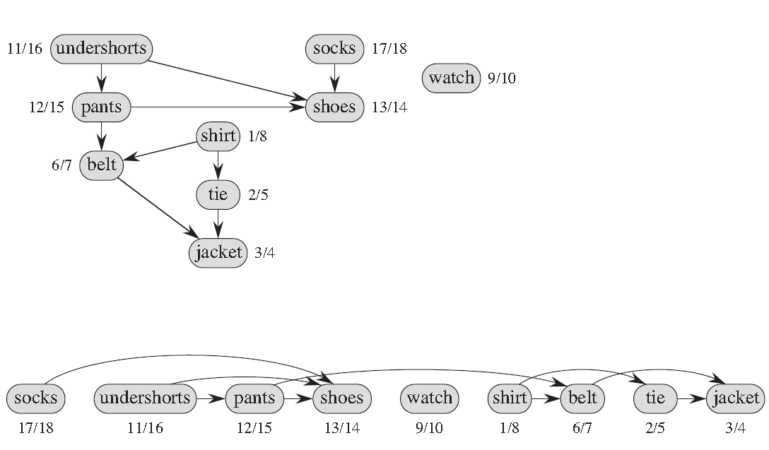
Using DFS for Topological Sorting

Slide 36
Correctness of Topological Sort
Claim: (u,v) ∈ G and G is directed, acyclic ⇒ u.f > v.f
  When (u,v) is explored, u is grey
    v = grey ⇒ (u,v) is back edge. Contradiction, since G is DAG and contains no back edges
    v = white ⇒ v becomes descendent of u ⇒ v.f < u.f
    (since it must finish v before backtracking and finishing u)
    v = black ⇒ v already finished ⇒ v.f < u.f

Slide 37
Applications of DFS
For undirected graphs:
  Connected components
  Connectivity properties
For directed graphs:
  Finding cycles
  Topological sorting
  Connectivity properties: Strongly connected components

Slide 38
Strongly Connected Components
A strongly connected component of a directed graph G=(V,E) is a maximal set of vertices C such that for every pair of vertices u and v in C, both vertices u and v are reachable from each other.

Slide 39
Strongly connected components - Example
a
b
c
d
e
f
g
h

Slide 40
Strongly connected components – Example – The Component Graph
cd
abe
h
fg
The Component Graph results by collapsing each
strong component into a single vertex

Slide 41
The Component Graph
Property: The Component Graph is a DAG (directed acyclic graph)

Slide 42
Strongly connected components
Strongly connected components of a directed graph G
Algorithm principle: (Kosaraju-Sharir algorithm)
  Call DFS(G) to compute finishing times u.f for every vertex u
  Compute GT, the transpose of graph G
  Call DFS(GT), but in the main loop of DFS, consider the vertices in order of decreasing u.f as computed in step 1
  Output the vertices of each DFS-tree formed in step 3 as the vertices of a strongly connected component

Slide 43
Strongly connected components - Example
Step1: call DFS(G), compute u.f for all u
a
b
c
d
13/14
11/16
1/10
8/9
12/15
3/4
2/7
5/6
e
f
g
h

Slide 44
Strongly connected components - Example
Step2: compute GT
a
b
c
d
13/14
11/16
1/10
8/9
12/15
3/4
2/7
5/6
e
f
g
h

Slide 45
Strongly connected components - Example
Step3: call DFS(GT), consider vertices in order of decreasing u.f
a
b
c
d
13/14
11/16
1/10
8/9
12/15
3/4
2/7
5/6
e
f
g
h

Slide 46
Strongly connected components - Example
Step3: call DFS(GT), consider vertices in order of decreasing u.f
a
b
c
d
13/14
11/16
1/10
8/9
12/15
3/4
2/7
5/6
e
f
g
h

Slide 47
Strongly connected components - Example
Step3: call DFS(GT), consider vertices in order of decreasing u.f
a
b
c
d
13/14
11/16
1/10
8/9
12/15
3/4
2/7
5/6
e
f
g
h

Slide 48
Strongly connected components - Example
Step3: call DFS(GT), consider vertices in order of decreasing u.f
a
b
c
d
13/14
11/16
1/10
8/9
12/15
3/4
2/7
5/6
e
f
g
h

Slide 49
Strongly connected components - Example
Step3: call DFS(GT), consider vertices in order of decreasing u.f
a
b
c
d
13/14
11/16
1/10
8/9
12/15
3/4
2/7
5/6
e
f
g
h

Slide 50
Proof of
Strong Components Algorithm
Theorem
The Algorithm presented before finds the strong components of G.
Proof
We must show that a set of vertices forms a strong components if and only if they are vertices of a tree in the DFS-forest of G^{T}

Slide 51
Proof (cont)
Suppose that v,w are vertices in the same strong component
There is a DFS search in GT which starts at a vertex r and reaches v.
Since v, w are in the same strong component, there is a path from v to w and from w to v. => then w will also be reached in this DFS search
=> Vertices v,w belong to the same spanning tree of GT.

Slide 52
Proof (cont)
Suppose v,w are two vertices in the same DFS-spanning tree of GT.
Let r be the root of that spanning tree.
Then there exists paths in GT from r to each of v and w.
So there exists paths in G to r from each of v and w.

Slide 53
Proof (cont)
We will prove that there are paths in G from r to v and w as well
We know that r.f > v.f (when r was selected as a root of its DFS-tree)
If there is no path from r to v, then it is also no path from v to r, which is a contradiction
Hence, there exists path in G from r to v, and similar argument gives path from r to w.
So v and w are in a cycle of G and must be in the same strong component.

Slide 54
Summary
Applications of Depth-First Search
  Undirected graphs:
    Connected components, articulation points, bridges, biconnected components
  Directed graphs:
    Cyclic/acyclic graphs
    Topological sort
    Strongly connected components

